Slide 1



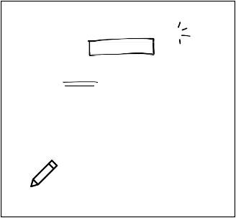





Canva Tips for Whiteboards
Customer Support Workflow Diagram
Sticky Notes
Draw Tool
Press "S" to create sticky notes.
Alternatively, click on the Elements tab to open the Sticky Notes panel.
Draw on your Whiteboard! Click ‘Draw’ on the object panel to activate different drawing tools and the eraser on your board.
You can also access panels for Lines & Shapes, Charts, and Tables in this tab.
Customer sends ticket about a concern
Explain a customer service process one step at a time
Start
S
Elements
Draw
Lines and Shapes
Customer Support receives the ticket
Decision Point Does the concern require expert insight?
Customer Support sends ticket to appropriate department
Department provides answer to the concern
Customer Support relays information to user
Decision Point Are there other concerns?
Yes
Press "L" to generate lines.
Double-click on the line to add text.
Click on the lines and choose among the options on the editor bar to create elbowed lines and add arrowheads.
Add text
No
No
L
Drag the text along the line
Customer support representative responds to user's concern directly
Finish
Press "R" to generate a rectangle.
Press "C" to generate a circle.
R
C
Text
Decision Point
Action Point
Embed
Magic Shortcut
Collaborate
Embed videos, presentations,
and more onto your Whiteboard. Just directly paste their links onto the template!
Design with the /Magic shortcut.
Click the "+" to add people to the Whiteboard. Share the link so you can all collaborate in real time!
Press "/" while on the
Whiteboard and search for whatever you need, such as
emojis, charts, and the timer!
You can also access Embeds in the Apps Tab of the Object Panel.
</>
Copy Link
/

Slide 2
Agent-based model decision tree workflow used.
START
Start
Agents are generated in the flooded area per group
Are pixels available in the same group as the agent?
Yes
Are there transport and infrastructure variables enabled
Yes
Are the expansion settings enabled?
Is the aggressive urban expansion scenario enabled?
Agents move to areas with similar groups and the highest infrastructure and transport value under a aggressive urban expansion scenario.
Yes
Yes
No
No
No
No
Begin and end points
Agents don’t move the original point.
Agents move to areas with similar group properties randomly.
Agents move to areas with similar groups and the highest infrastructure and transport value only at the urban perimeter.
Agents move to areas with similar groups and the highest infrastructure and transport value under a strict urban expansion scenario.
Decision Point
Agent selection
Type
END
END
END
END
END
1
2
3
4

Slide 4
Framework of the agent-based model for relocation scenarios
START
Start
Agents are generated in the flooded area per group
Are pixels available in the same group as the agent?
Yes
Are there transport and infrastructure variables enabled
Yes
Are the expansion settings enabled?
Is the aggressive urban expansion scenario enabled?
Agents move to areas with similar groups and the highest infrastructure and transport value under a aggressive urban expansion scenario.
Yes
Yes
No
No
No
No
Begin and end points
Agents don’t move the original point.
Agents move to areas with similar group properties randomly.
Agents move to areas with similar groups and the highest infrastructure and transport value only at the urban perimeter.
Agents move to areas with similar groups and the highest infrastructure and transport value under a strict urban expansion scenario.
Parameter
Initial / final outcomes
Scenario 3
Scenario 1
Scenario 2
Scenario 4
Scenario 5

Slide 6
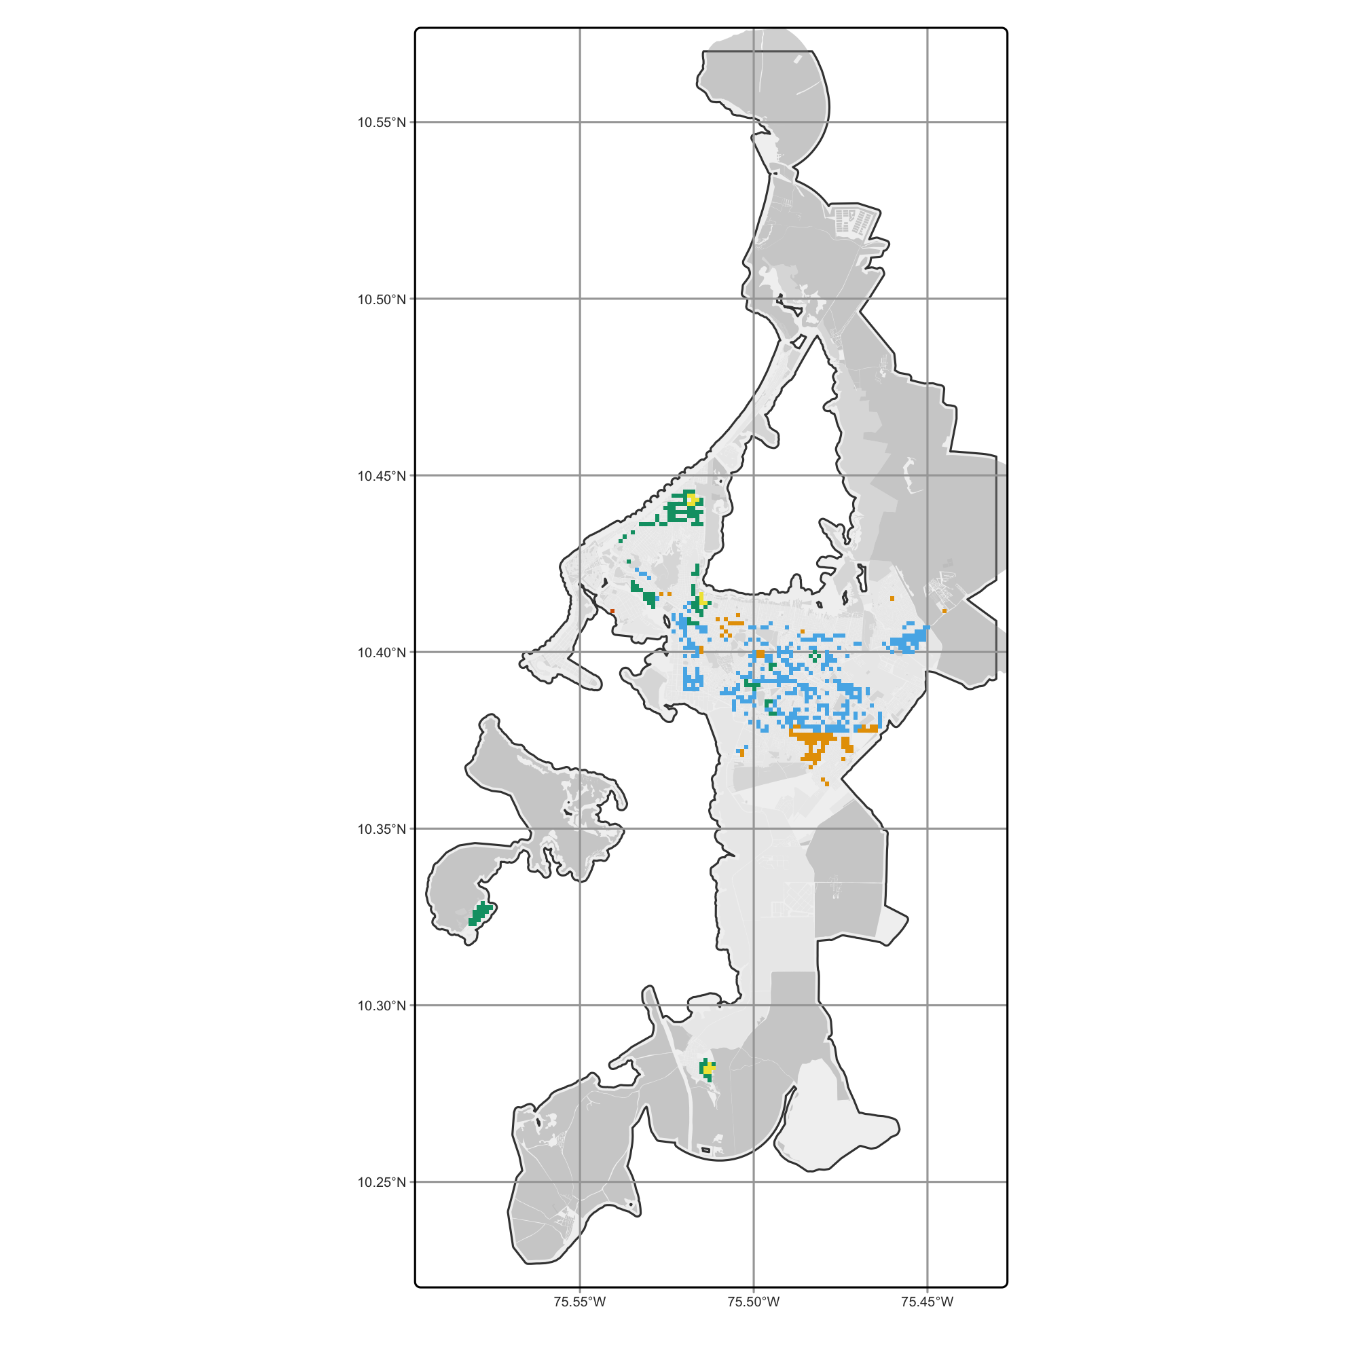
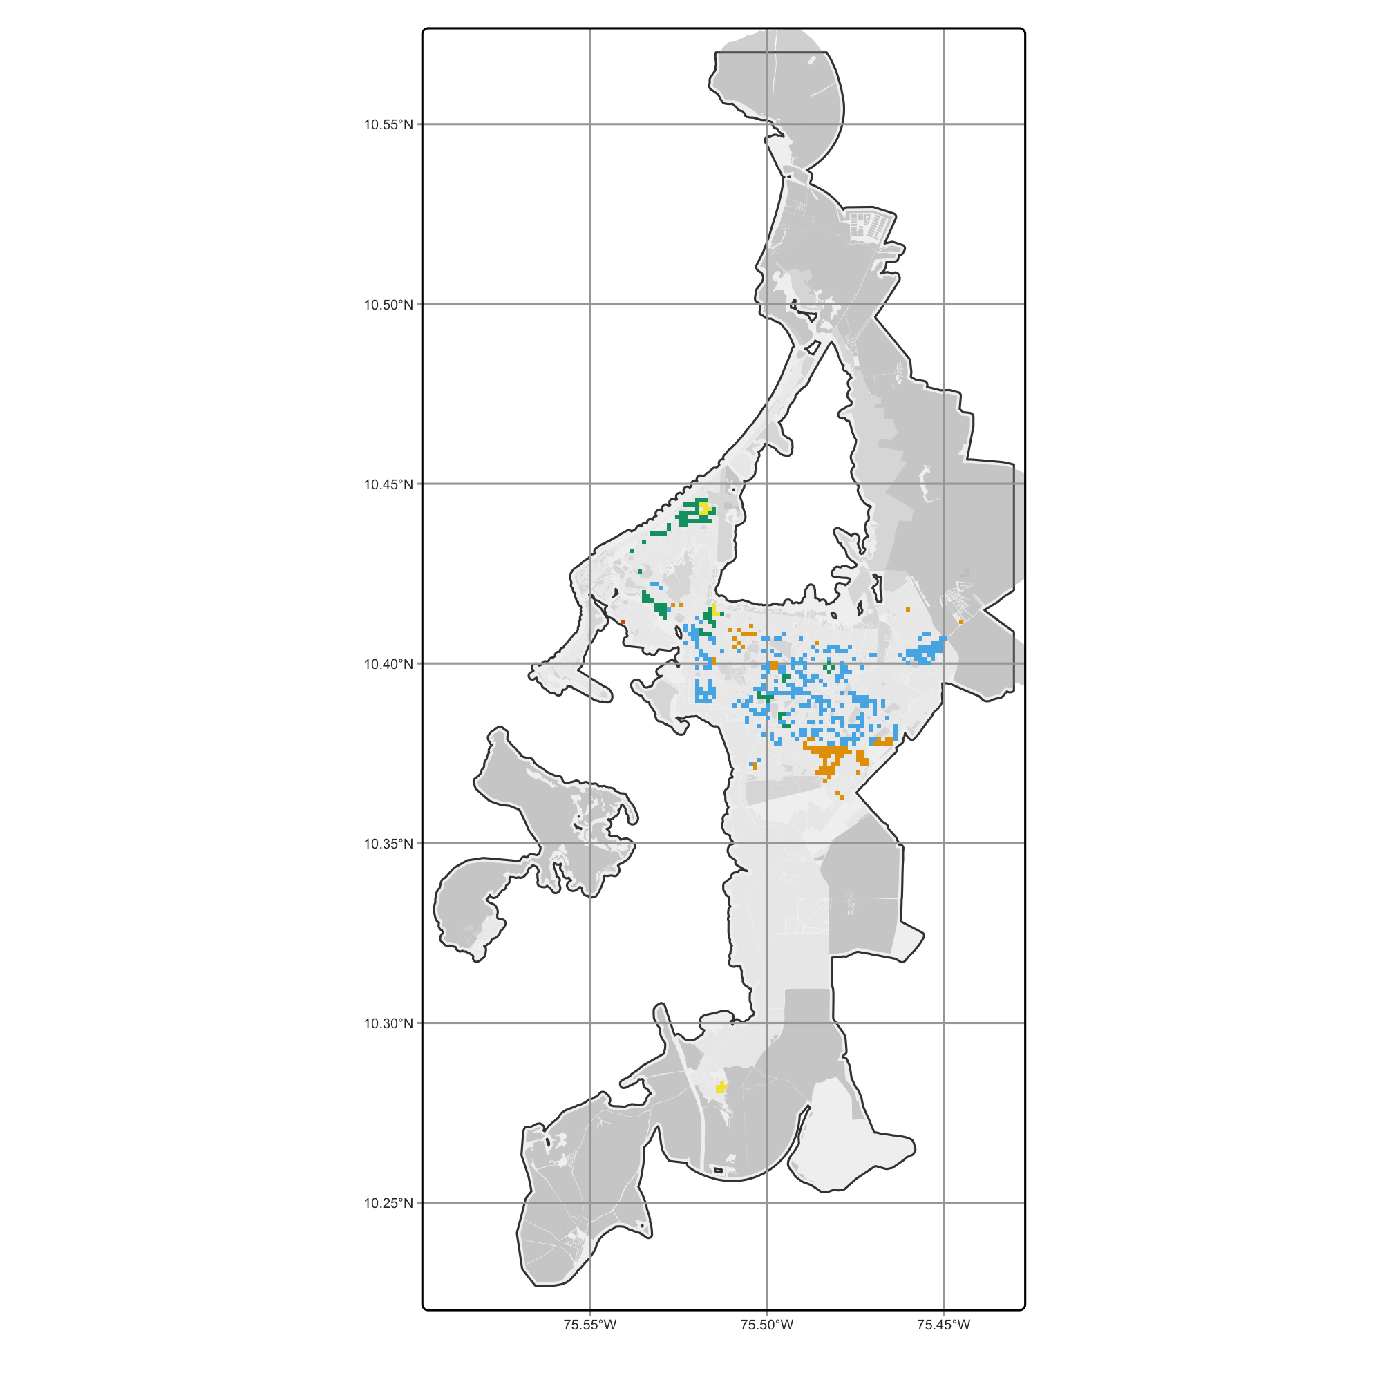
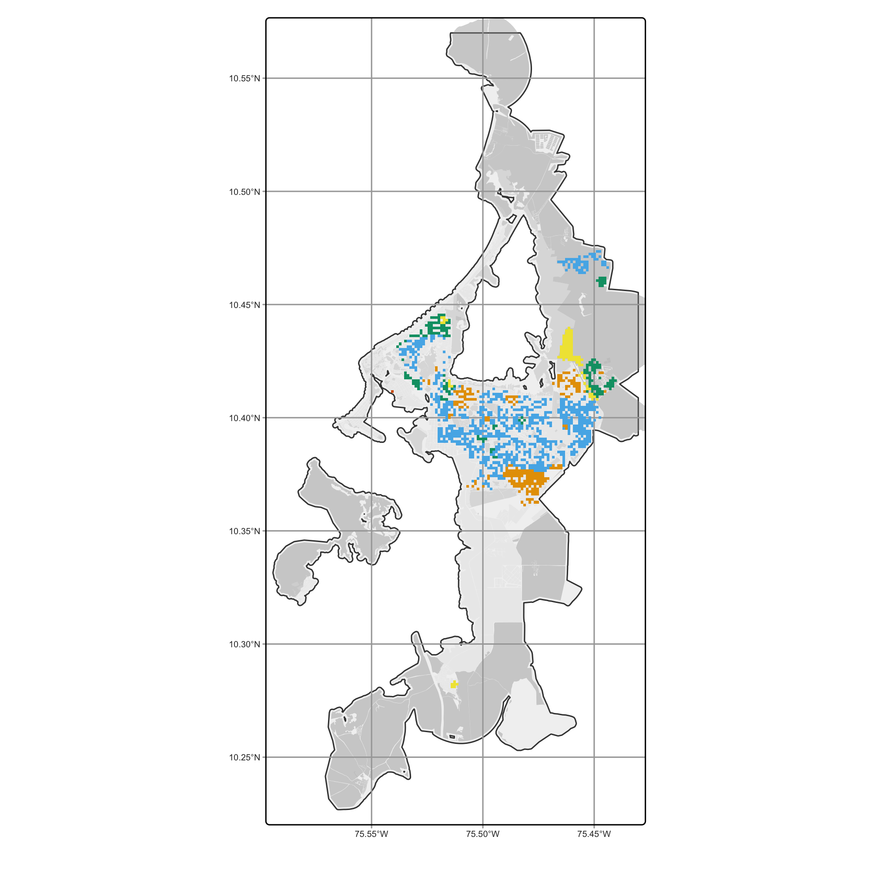
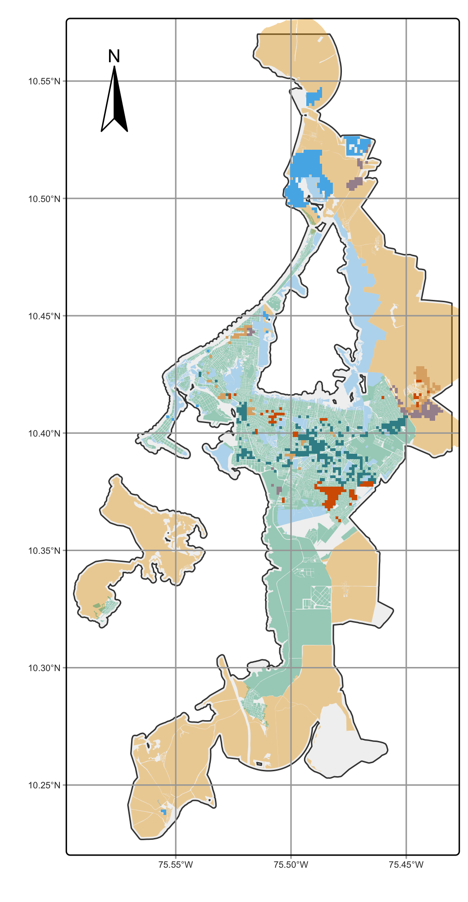
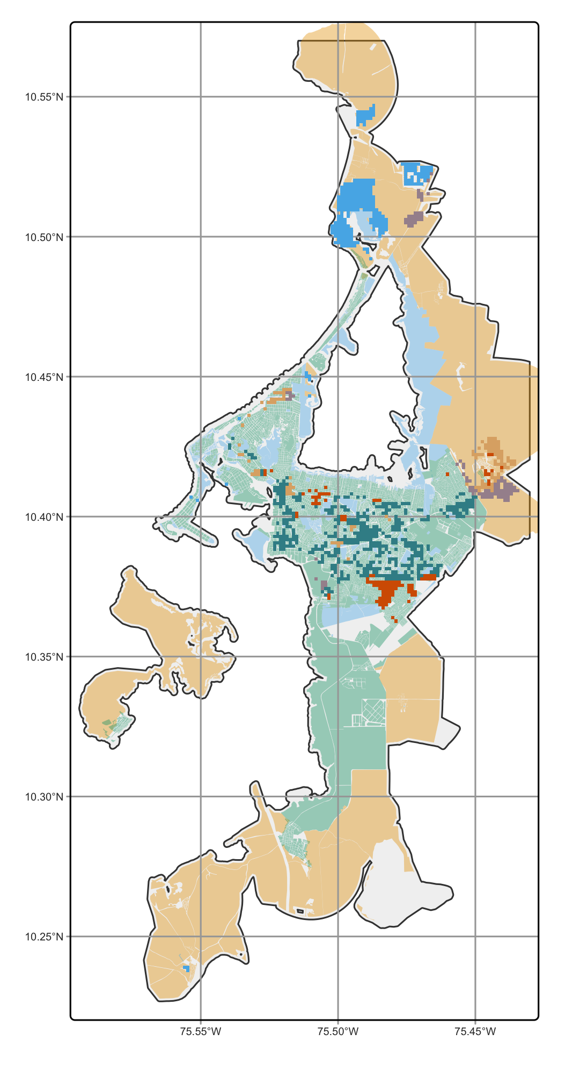

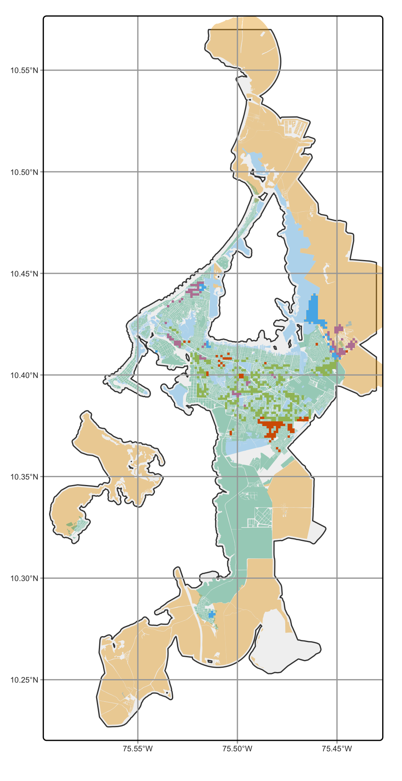
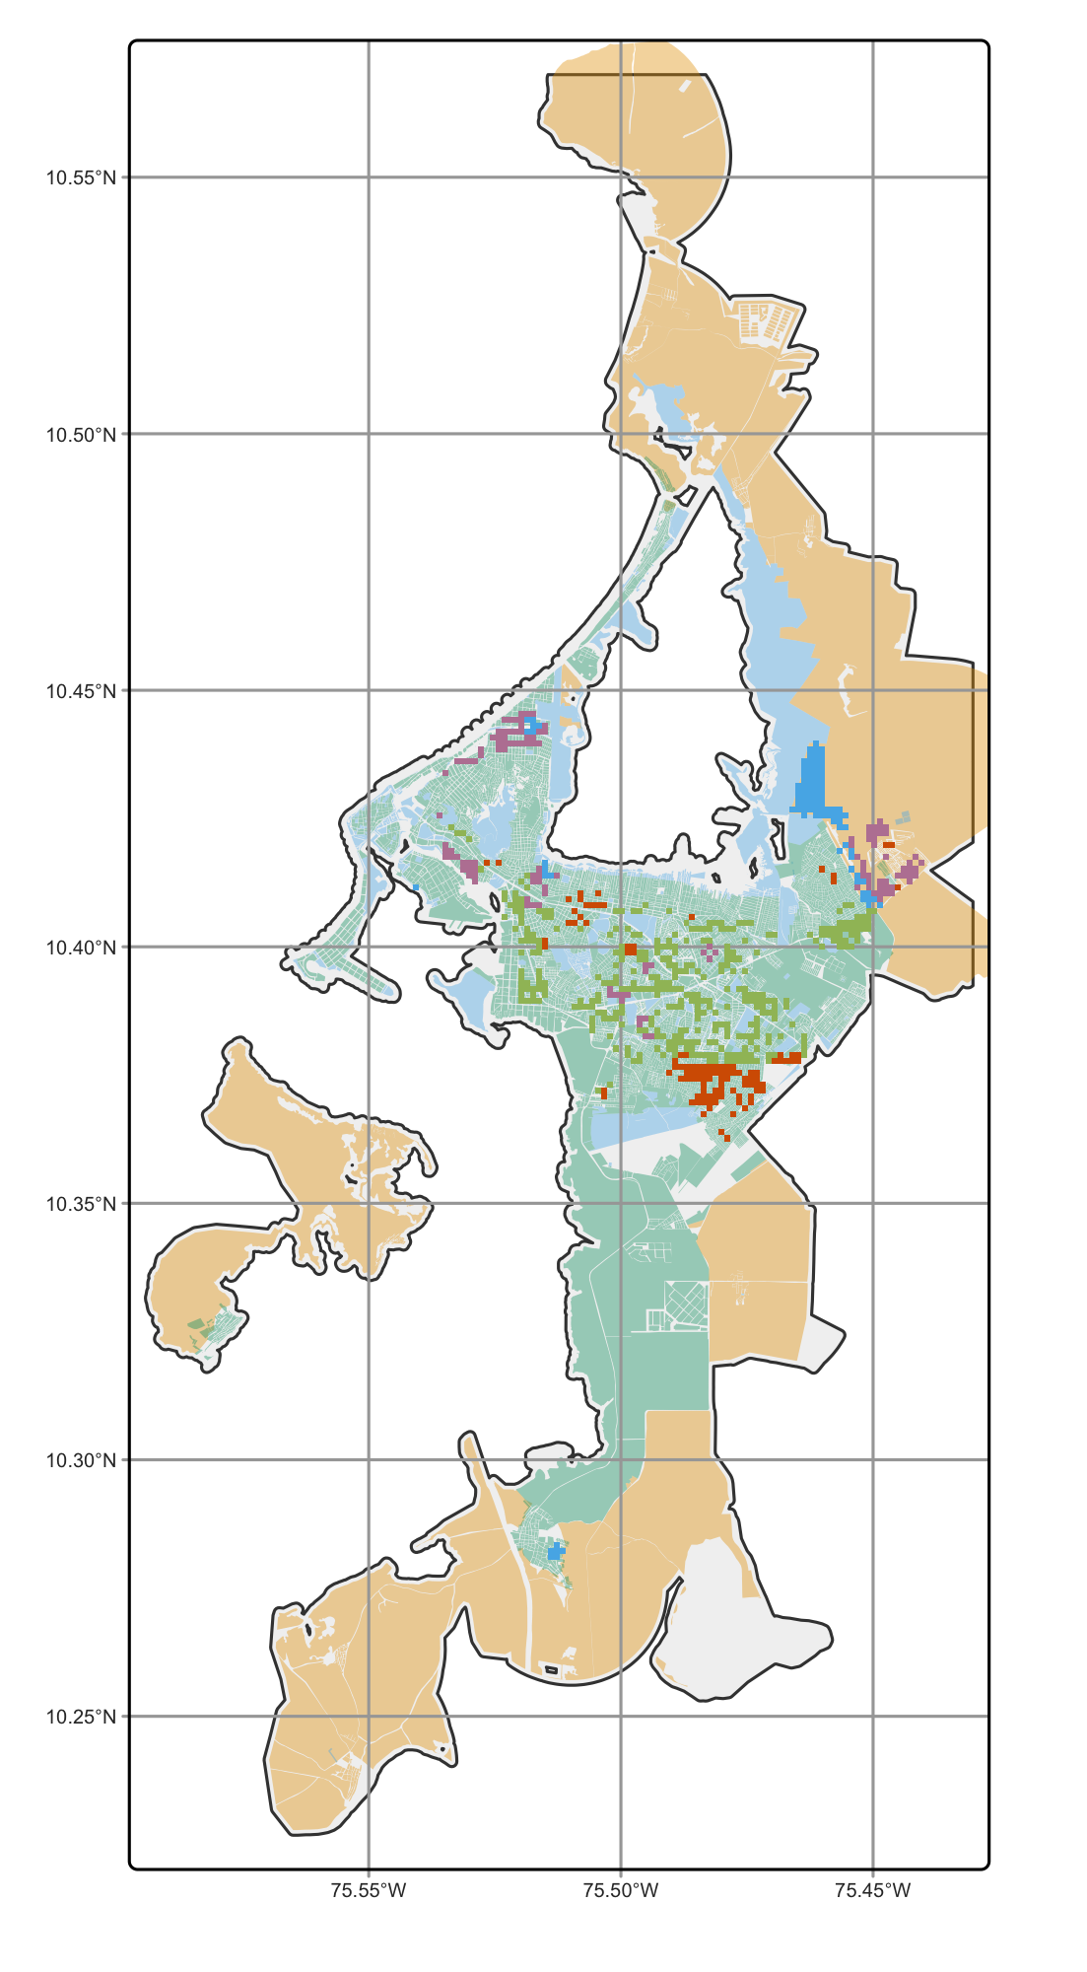
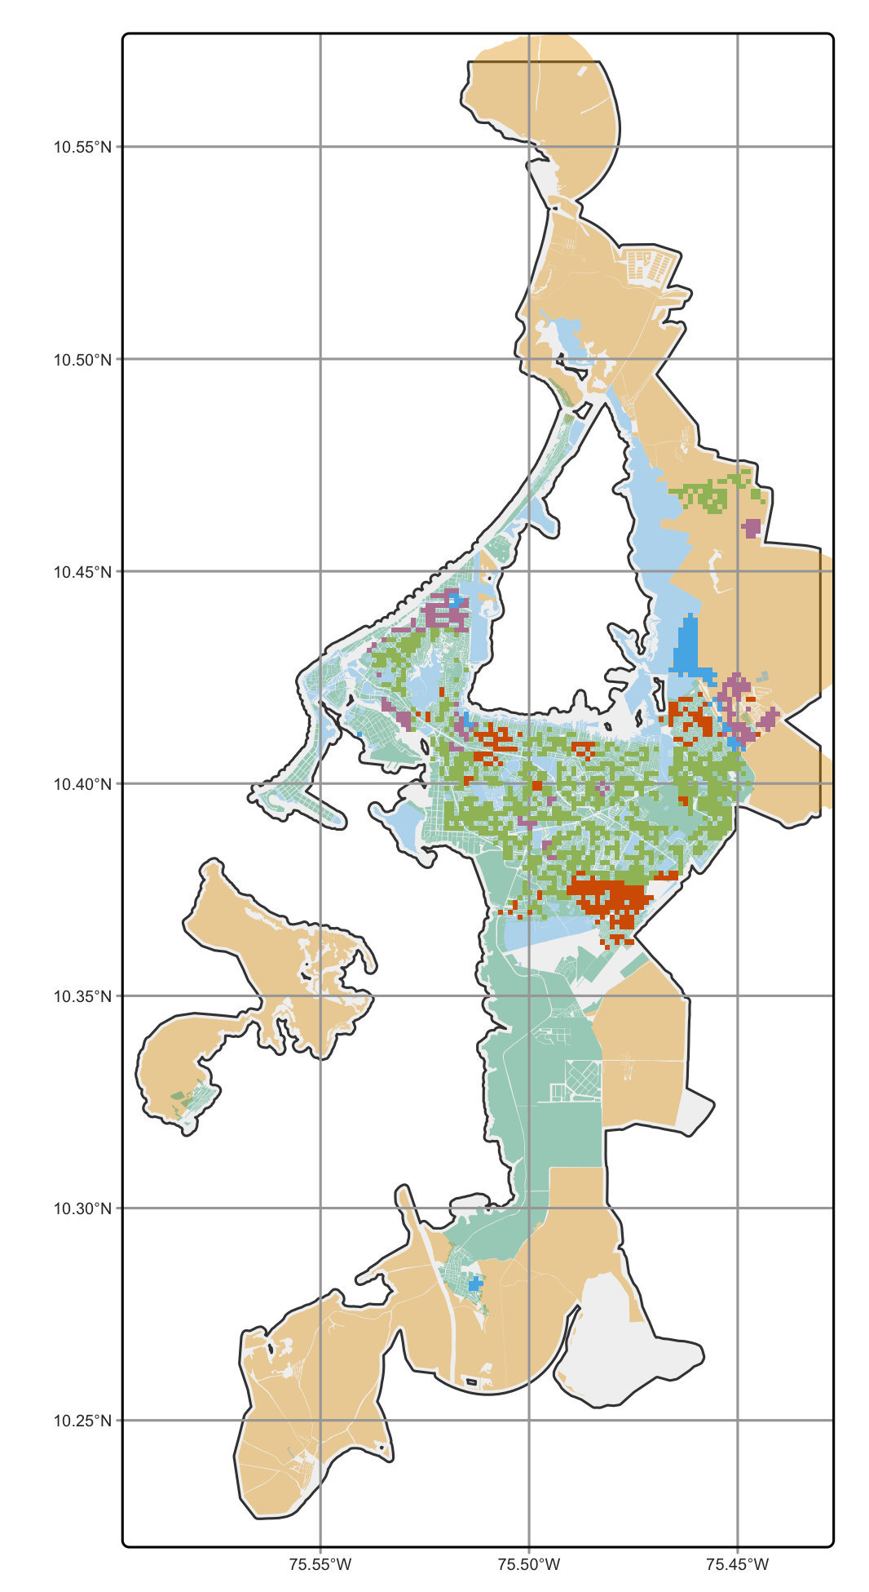
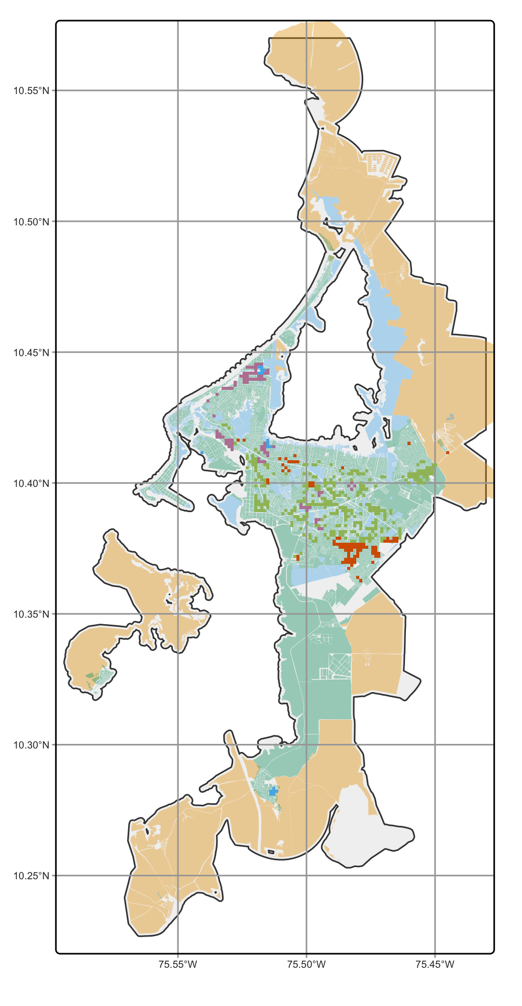
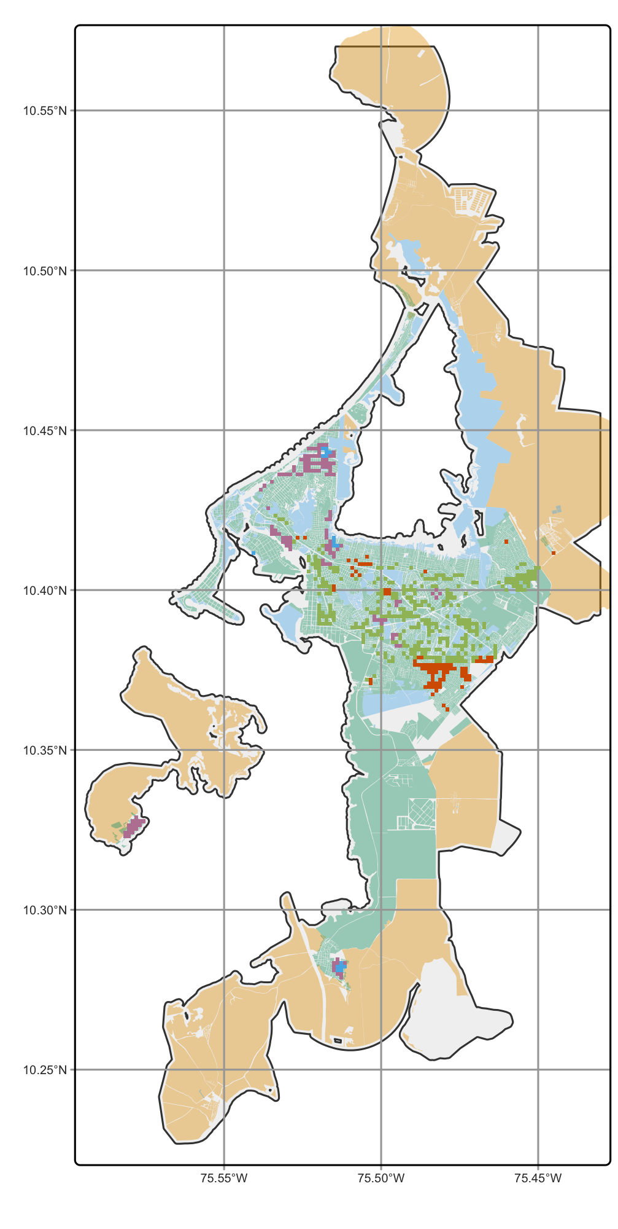
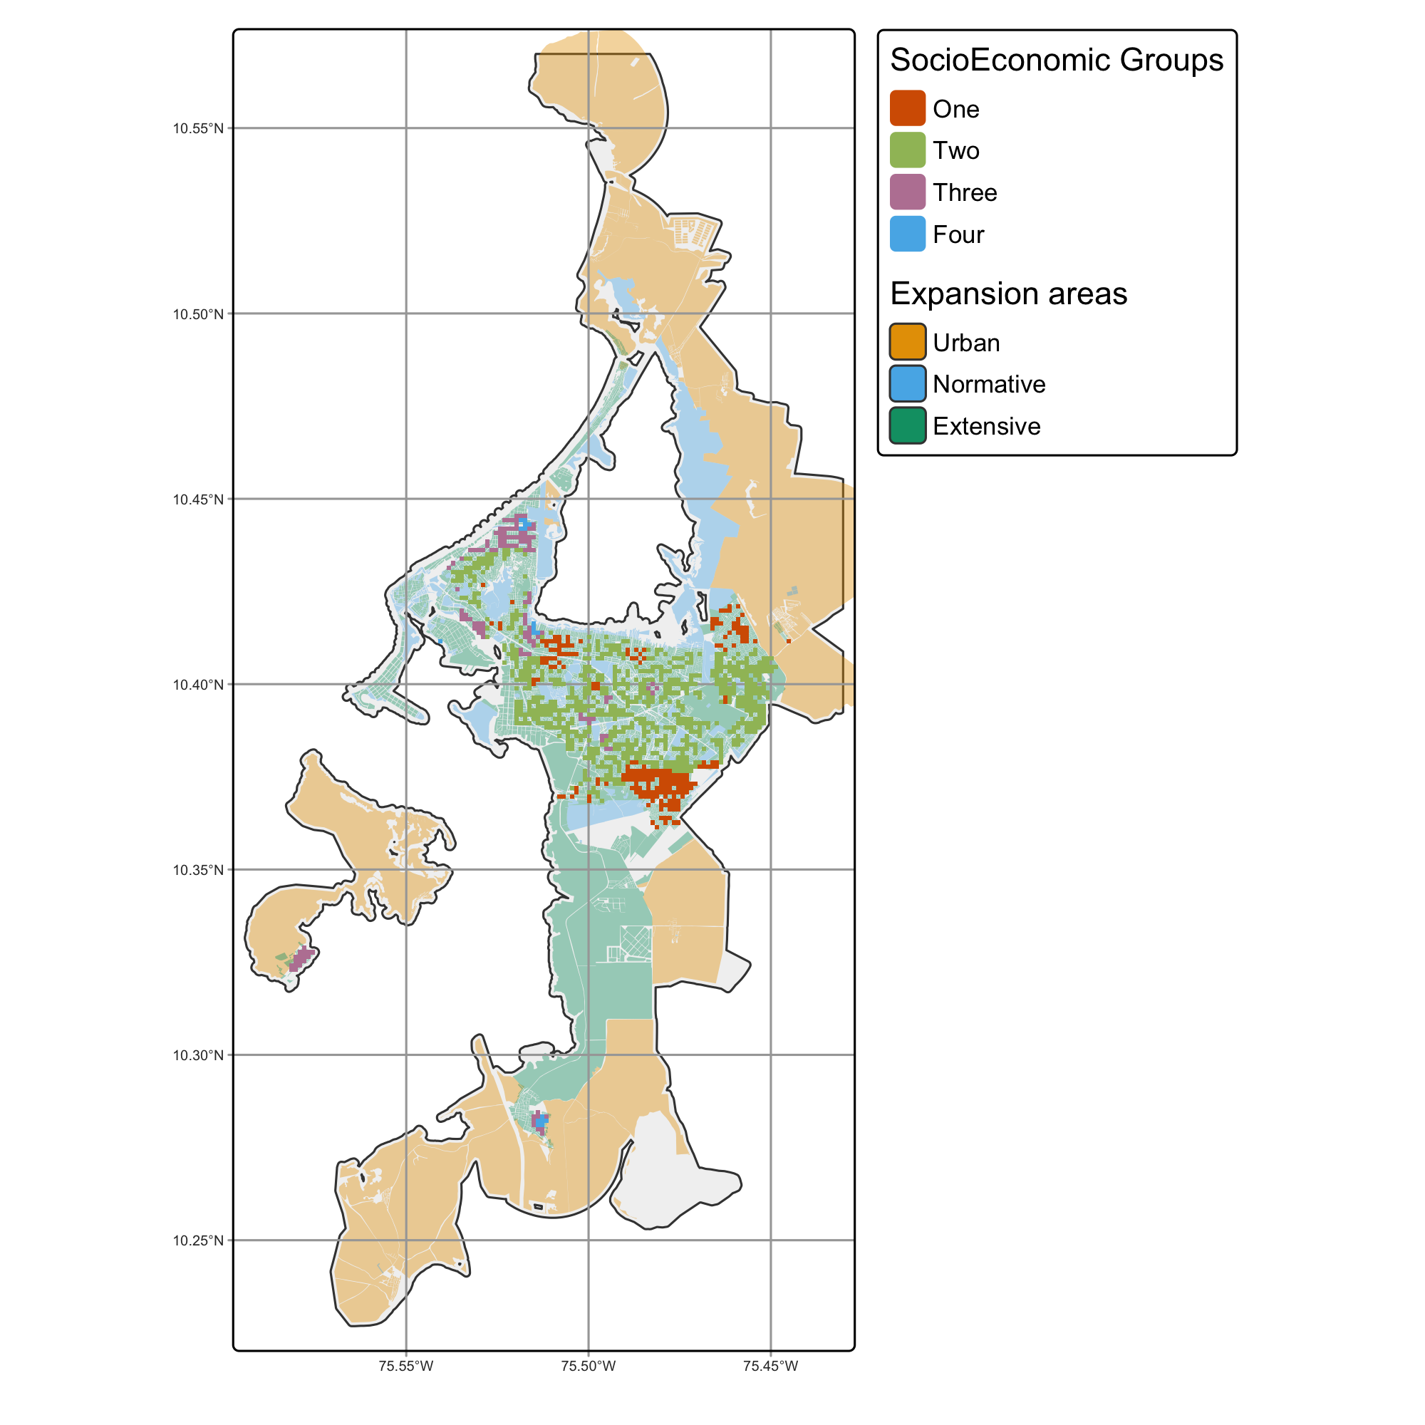
0%
30%
70%
Extensive
Normative
EXPANSION TYPE
Without expansion
CONSTRAINS

Slide 8
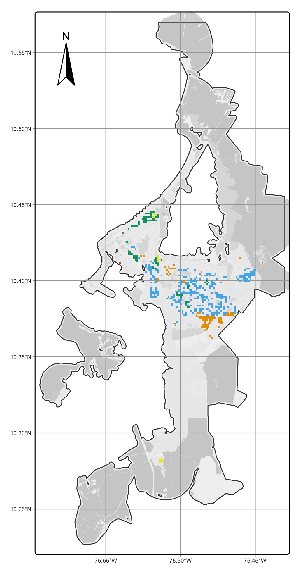
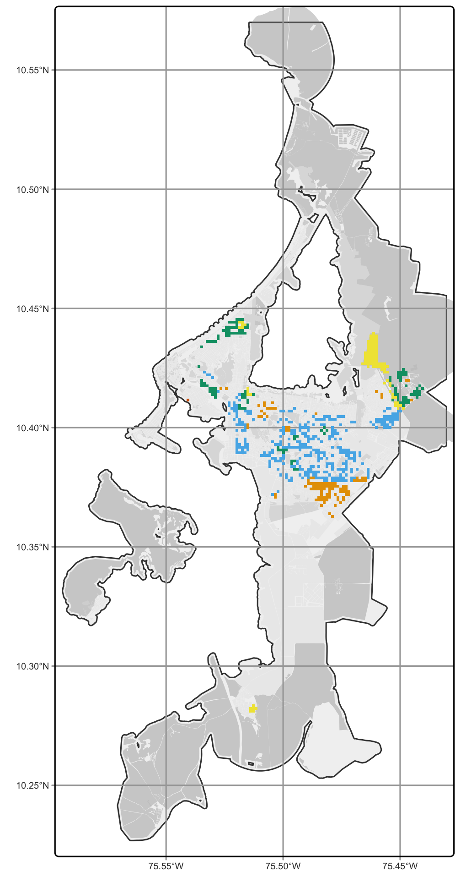
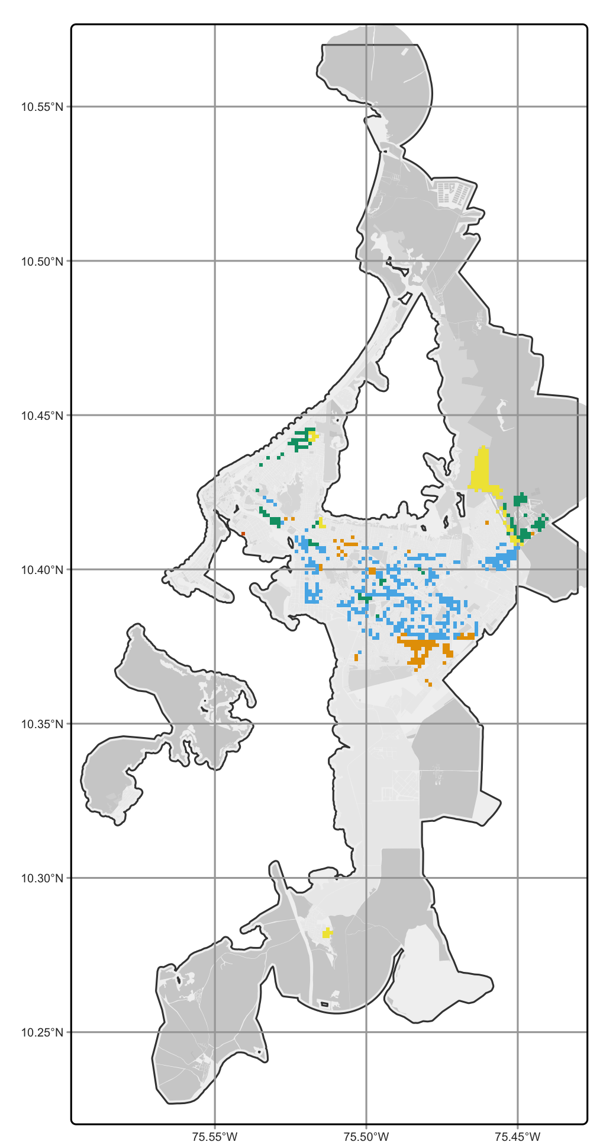
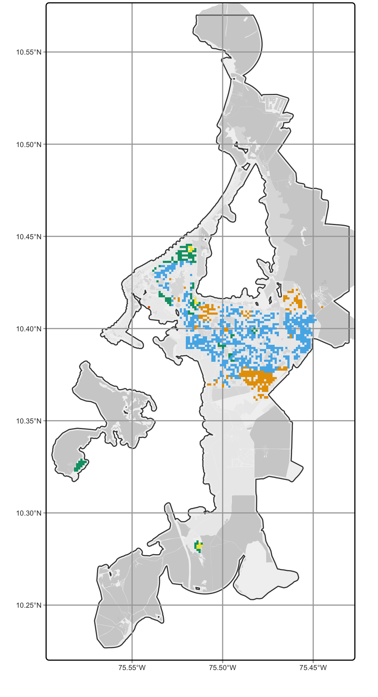
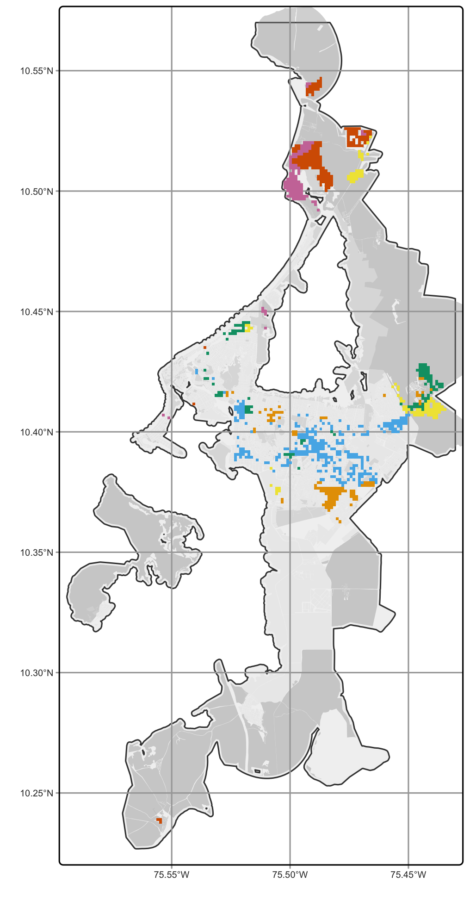
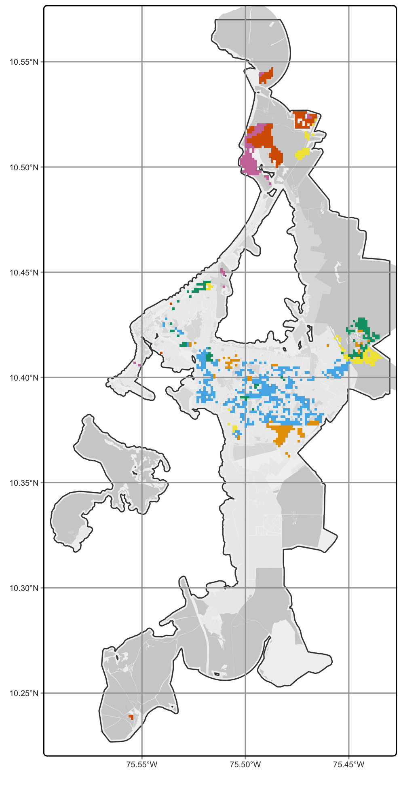
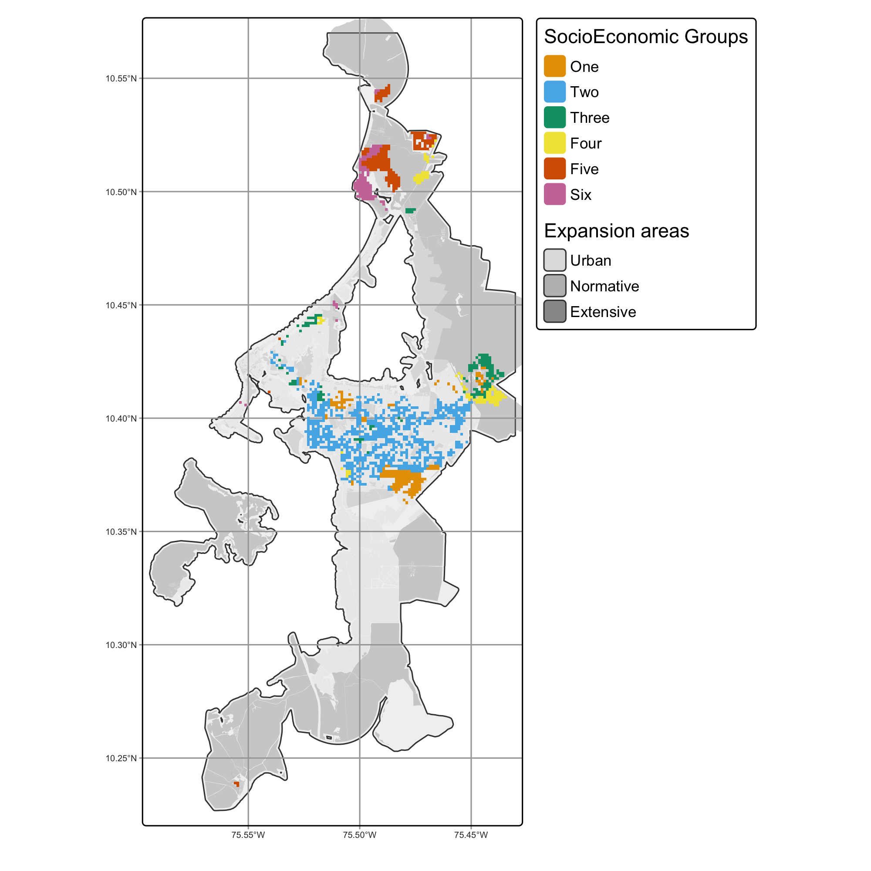

Slide 9
0%
30%
70%
Without expansion
EXPANSION TYPE
Normative
Extensive
CONSTRAINS

Slide 11


